Slide 1
Your Voice, Needs, and School Dollars
Su Voz, Necesidades, y El Dinero Escolar
Feb 19, 2020
Sasha Shane, Bay Area PLAN
Angelica Jongco, Public Advocates
Copyright 2020, Public Advocates Inc. All Rights Reserved. Contact ajongco@publicadvocates.org for permission prior to use.

Slide 2
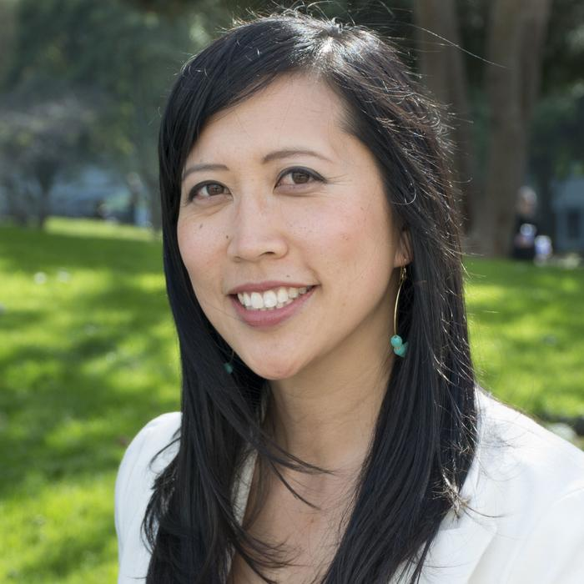
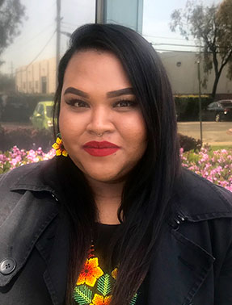
ABOUT US
Angelica Jongco
@edequitylawyer
Sasha Shane
Copyright 2020 Public Advocates Inc. All Rights Reserved. Contact ajongco@publicadvocates.org for permission prior to use.

Slide 3
Welcome
Bienvenidos
REFLECTION:
Think about a party or event that you had to plan.
REFLEXIÓN:
Piense en una fiesta o evento que ha tenido que planear.
What steps did you take to plan it?
¿Cuales pasos tomó para planificar?
What was most important to you? How did you decide?
¿Qué fue lo más importante para usted? Como lo decidio?
How did it go?
¿Como le fue?
Copyright 2020 Public Advocates Inc. All Rights Reserved. Contact ajongco@publicadvocates.org for permission prior to use.

Slide 4
Welcome
Bienvenidos
REFLECTION:
What if you had to do the party over again but with less money?
REFLEXIÓN:
¿Qué pasaría si tuvieras que volver a hacer la fiesta pero con menos dinero?
Would you do anything differently?
How would you decide what to change?
¿Harías algo diferente?
¿Cómo decidirías qué cambiar?
Copyright 2020 Public Advocates Inc. All Rights Reserved. Contact ajongco@publicadvocates.org for permission prior to use.

Slide 5
Agenda:
9:30-9:50am (20 min)
9:50-10:30am (40min)
10:30-10:50am (20min)
10:50-11am (10min)
11-11:40am (40min)
11:40am -12pm (15min)
Welcome & Introductions
Bienvenidos y Presentaciónes
Local Control Funding Formula (LCFF) 101 & Activity
Repaso de la Fórmula de Financiamiento de Control Local (LCFF) y Actividad
LCAP & Opportunities for involvement
LCAP y Oportunidades para involucrarse
Break / Descanso
LCAP Review & Activity
Repaso del LCAP y Actividad
Reflection, Next Steps & Evaluation
Reflección, Próximos Pasos y Evaluación
Copyright 2019, Public Advocates Inc. All Rights Reserved. Contact cgerges@publicadvocates.org for permission prior to use.

Slide 6
Purpose: Build parents’ knowledge and comfort to get involved in district decision-making.
Propósito: Aumentar el conocimiento de padres para involucrarse en la toma de decisiones en el distrito.
Learning Goals:
1: Understand the Local Control Funding Formula (LCFF)
Metas de aprendizaje:
1: Entender la Fórmula de Financiamiento de Control Local (LCFF)
2: Become familiar with the cycle of the school district’s Local Control Accountability Plan (LCAP) and budget
2: Familiarizarse con el ciclo del Plan de Responsabilidad y Control Local (LCAP) y el presupuesto
3: Compartir varias oportunidades que tienen los padres/madres para impactar el LCAP y lograr las necesidades de nuestro hijos/ajs
3: Share various opportunities that parents have to impact the LCAP to meet our children’s needs
Copyright 2020 Public Advocates Inc. All Rights Reserved. Contact ajongco@publicadvocates.org for permission prior to use.

Slide 7
What is the Local Control Funding Formula (LCFF)?
¿Qué es la Fórmula de Financiamiento de Control Local (LCFF)?
Copyright 2019, Public Advocates Inc. All Rights Reserved. Contact cgerges@publicadvocates.org for permission prior to use.

Slide 8
Source: Public Advocates https://youtu.be/lFQOjG7IUac; Spanish https://youtu.be/Oy68M8YPJZY
Copyright 2020, Public Advocates Inc. All Rights Reserved. Contact ajongco@publicadvocates.org for permission prior to use.

Slide 9
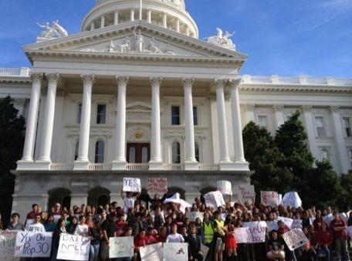
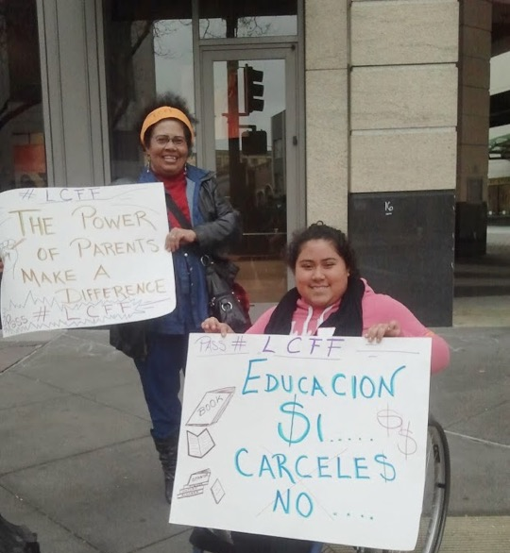
THIS IS OUR LAW!
¡ÉSTA ES NUESTRA LEY!
Copyright 2019, Public Advocates Inc. All Rights Reserved. Contact cgerges@publicadvocates.org for permission prior to use.

Slide 10
WHAT’S NEW?
¿QUÉ HAY DE NUEVO?
Multiple Measures
Varias Medidas
Fair Funding
Financiación Justa
Engagement
Involucración
2
3
1
School funding is now based on who NEEDS IT MOST!
¡Los fondos escolares ahora se basan en quienes LO NECESITAN MÁS!
District must work with the community to decide how to spend its money!
¡Distrito debe trabajar con la comunidad para decidir cómo gastar el dinero!
Multiple measures of school success, including: engagement and school climate.
Varias medidas de éxitos escolares incluyendo: involucramiento y clima escolar.
Copyright 2019, Public Advocates Inc. All Rights Reserved. Contact cgerges@publicadvocates.org for permission prior to use.

Slide 11
LCFF: NEW FUNDING SYSTEM
FÓRMULA DE FINANCIAMIENTO DE CONTROL LOCAL (LCFF)
LCAP: NEW DISTRICT
PLANNING PROCESS
PLAN DE RESPONSABILIDAD Y CONTROL LOCAL (LCAP)
DASHBOARD: NEW
ACCOUNTABILITY SYSTEM
TABLERO DE MANDOS
ESCOLAR DE CALIFORNIA
Copyright 2019, Public Advocates Inc. All Rights Reserved. Contact cgerges@publicadvocates.org for permission prior to use.

Slide 12
The Formula La Formula
Concentration Concentración
Supplemental Suplementario
Base
(2019-20)
Almost/Casi $10,000 per
student/
por estudiante
$$$
$$$
Copyright 2019, Public Advocates Inc. All Rights Reserved. Contact cgerges@publicadvocates.org for permission prior to use.

Slide 13
¿Quiénes son estudiantes de alta necesidad bajo el LCFF?
Who are high-need students under LCFF?
Copyright 2020, Public Advocates Inc. All Rights Reserved. Contact ajongco@publicadvocates.org for permission prior to use.

Slide 14
High-Need Students
Estudiantes de Alta Necesidad
English Learners
Estudiantes de Aprendices de Inglés
Low-income Students
Estudiantes de Bajos Ingresos
Foster Youth
Jóvenes de Crianza
Copyright 2020, Public Advocates Inc. All Rights Reserved. Contact ajongco@publicadvocates.org for permission prior to use.

Slide 15
Time to Practice!
¡Tiempo para Practicar!

Slide 16
Fondos Suplementarios y de Concentración (S&C) deben ser usados para AUMENTAR Y/O MEJORAR servicios para estudiantes de Alta Necesidad comparado a todos los estudiantes
Concentration Concentración
Supplemental Suplementario
Base
(2018-19)
Almost $10,000/ student
estudiante
Supplemental and Concentration Funds (S&C) should be used to INCREASE or IMPROVE services for high-need students, as compared to all students.
Copyright 2020, Public Advocates Inc. All Rights Reserved. Contact ajongco@publicadvocates.org for permission prior to use.

Slide 17
What is the Local Control Accountability Plan (LCAP)?
¿Qué es el Plan de Responsabilidad y Control Local (LCAP)?
Copyright 2020, Public Advocates Inc. All Rights Reserved. Contact ajongco@publicadvocates.org for permission prior to use.

Slide 18
The LCAP
El LCAP
District’s plan for addressing student needs.
Called Local Control and Accountability Plan (LCAP for short).
Must set goals on a number of priorities, including 1) academic performance, 2) parent and student engagement and 3) school climate.
Debe medir el progreso hacia las metas
El plan del distrito para abordar las necesidades de estudiantes.
Llamado plan de responsabilidad y control local (LCAP por corto).
Debe de crear metas para reflejar una serie de prioridades, incluyendo 1) academic performance 2) la involucración de padres y estudiantes y 3) el ambiente escolar.
Copyright 2020, Public Advocates Inc. All Rights Reserved. Contact ajongco@publicadvocates.org for permission prior to use.

Slide 19
Phase 1: Planning
Make revisions and refine the plan using the information gathered in the Third Phase
Determine needs, define goals, actions, services, and metrics
Phase 4:
Modify
LCAP Process
Phase 2: Do
Analyze, review, and share data. Ask: What is working and what is not working?
Gather information and data. How do we know that we are being effective?
Phase 3: Reflect

Slide 20
Fase 1: Planificar
Hacer revisiones y refinar el plan usando la información de la Tercera Fase.
Determinar necesidades, definir metas, acciones, servicios, y medidas.
Fase 4: Modificar
Proceso del LCAP
Fase 2: Hacer
Analizar, examinar, y comunicar datos. Pregunte: ¿qué funciona, qué no está funcionando?
Recopilar información y datos. ¿Cómo sabemos que estamos siendo efectivos?
Fase 3: Reflejar

Slide 21
10 min Break
Descanso

Slide 22
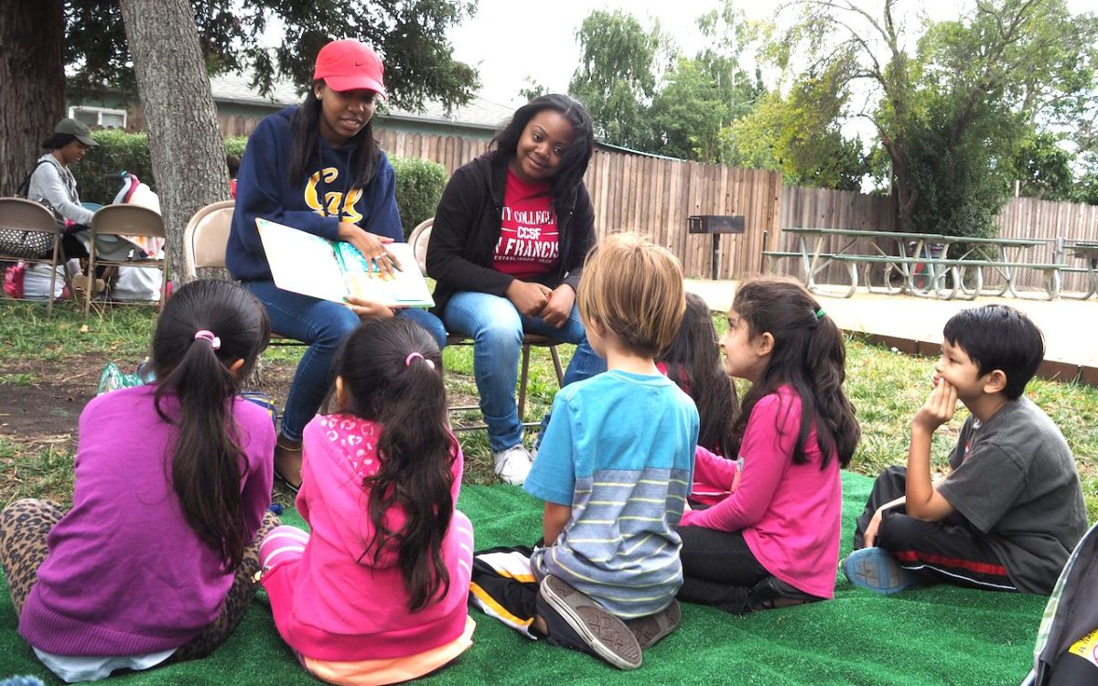
Why does this matter?
Share out:
What does your child need at school to succeed?
¿Por qué es importante?
Share out:
What does your child need at school to succeed?
Hayward Unified, Source: EdSource
Copyright 2019, Public Advocates Inc. All Rights Reserved. Contact cgerges@publicadvocates.org for permission prior to use.

Slide 23
How much money does HUSD
have to spend for schools?
¿Cuánto dinero tiene HUSD?
tiene que gastar para las escuelas?
Copyright 2020, Public Advocates Inc. All Rights Reserved. Contact ajongco@publicadvocates.org for permission prior to use.

Slide 24
$261 million
Federal (Restricted )
State
(LCFF & other programs)
Local (Parcel tax, grants)
$18 M
$223 M
$20 M
HUSD
Copyright 2020, Public Advocates Inc. All Rights Reserved. Contact ajongco@publicadvocates.org for permission prior to use.

Slide 25
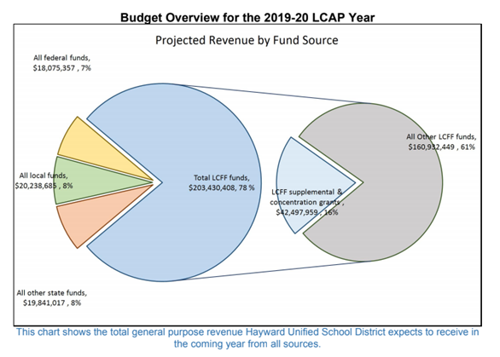
2019-20 - Budget Overview
Copyright 2019, Public Advocates Inc. All Rights Reserved. Contact cgerges@publicadvocates.org for permission prior to use.

Slide 26
Districts’ LCAP Budget
LCAP shows $65 M
$266 M
Copyright 2020, Public Advocates Inc. All Rights Reserved. Contact ajongco@publicadvocates.org for permission prior to use.

Slide 27
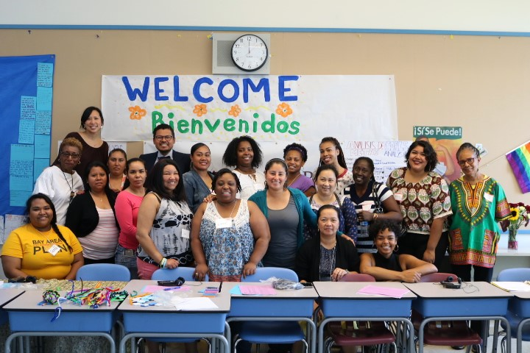
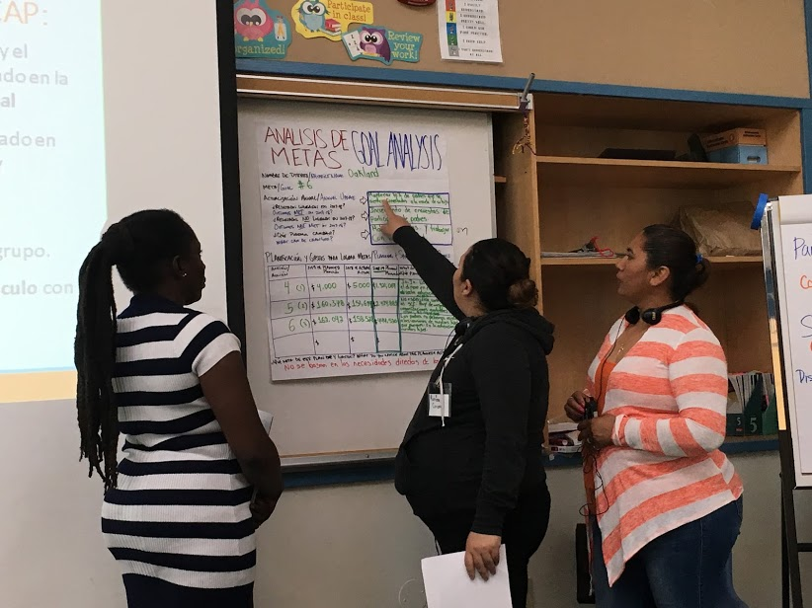
It’s your responsibility to ensure that the $$$
Makes a Difference
Es su Responsabilidad de Asegurarse que el $$$
Haga una Diferencia
Copyright 2020, Public Advocates Inc. All Rights Reserved. Contact ajongco@publicadvocates.org for permission prior to use.

Slide 28
LCAP Goal/Meta 6
Crear una clima escolar seguro y positivo por involucrar positivamente a los alumnos y abordendar las necesidades.
Por que?
Nuestros estudiantes necesitan sentirse seguros y atendidos en la escuela. Necesidades identificadas:
Relaciones positivas con el personal,
Estrategias para que los estudiantes y el personal resuelvan problemas, y
Apoyo para mejorar la resiliencia y el compromiso de los estudiantes.
Create a safe and positive school climate by positively engaging students and addressing needs.
Why?
Our students need to feel safe and cared for at school. Identified Needs:
Positive relationships with staff,
Strategies for students and staff to solve problems, and
Support to improve student resilience and engagement.
Copyright 2020, Public Advocates Inc. All Rights Reserved. Contact ajongco@publicadvocates.org for permission prior to use.

Slide 29
Measuring Progress /Medición de progreso
Keep Suspension Rate Below 4.25% / Mantener la Tasa de Suspensión menos de 4.25%
 | Actual Outcome 2017-18
All Students / Todos los estudiantes | 4.3% NOT MET / NO CUMPLIDO
African American / Afroamericanos | 11.4%
American Indian / Nativos Americanos | 13.6%
Students with Disabilities/ Estudiantes con necesidades especiales | 7.2%
Foster Students / Niños de crianza | 7.1%
Homeless / Sin hogar | 6.5%
White / Blancos | 4%
Copyright 2020, Public Advocates Inc. All Rights Reserved.
Contact ajongco@publicadvocates.org for permission prior to use.

Slide 30
Measuring Progress /Medición de progreso
Students report feeling safe at school increases by 5%.
Los estudiantes informan que sentirse seguros en la escuela aumenta en un 5%.
 | Actual Outcome 2017-18
5th Grade | 68% MET / CUMPLIDO
7th Grade | 54% NOT MET / NO CUMPLIDO
9th Grade | 39% NOT MET / NO CUMPLIDO
11th Grade | 37% NOT MET / NO CUMPLIDO
Copyright 2020, Public Advocates Inc. All Rights Reserved. Contact ajongco@publicadvocates.org for permission prior to use.

Slide 31
Measuring Progress / Medición de progreso
Students reporting a caring relationship with an adult at schools with expanded mental health & counseling increases by 5%.
Los estudiantes que informan una relación afectuosa con un adulto en las escuelas con un aumento de la salud mental y el asesoramiento aumenta en un 5%.
 | Actual Outcome 2017-18
Lorin Eden | 99% MET
Stonebrae | 97% MET
Southgate | 96% MET
Mt Eden 9th Grade | 83% NOT MET
Mt Eden 11th Grade | 79% NOT MET
Copyright 2020, Public Advocates Inc. All Rights Reserved.
Contact ajongco@publicadvocates.org for permission prior to use.

Slide 32
Biggest Goal 6 School Climate Investments /
Mayor objetivo 6 Inversiones en clima escolar
School safety & climate
Nurses & Counselors $5.5 million
School psychologists $3.8 million
Campus Safety Officers & School Police Contract - $3 million
Seguridad y clima escolar
Enfermeras y consejeros - $5.5 million
Psicólogos - $3.8 million
Oficiales de seguridad del campus y el Contrato de Policia- $3 million
Copyright 2020, Public Advocates Inc. All Rights Reserved. Contact ajongco@publicadvocates.org for permission prior to use.

Slide 33
Activity / Actividad
Step 1: Discuss whether to: keep the action the same, reduce the action and do something else, or expand it.
Why? What’s most important to your decision?
Does the action benefit high-need students in a special way?
What information is missing or questions do you have?
Step 2: Prepare 2 min public comment with your recommendation for the school board.
Paso 1: Discuta si: mantener la acción igual, reducir la acción y hacer otra cosa, o expandirla.
¿Por qué? ¿Qué es lo más importante para tu decisión?
¿La acción beneficia a los estudiantes con altas necesidades de una manera especial?
¿Qué información falta o preguntas tiene?
Paso 2: Prepare un comentario público de 2 minutos con su recomendación para la junta escolar.
Copyright 2020, Public Advocates Inc. All Rights Reserved. Contact ajongco@publicadvocates.org for permission prior to use.

Slide 34
¿Tienen nuestras escuelas suficiente dinero?
Do our schools have enough money?
Copyright 2020, Public Advocates Inc. All Rights Reserved. Contact ajongco@publicadvocates.org for permission prior to use.

Slide 35
Source: Education Week

Slide 36
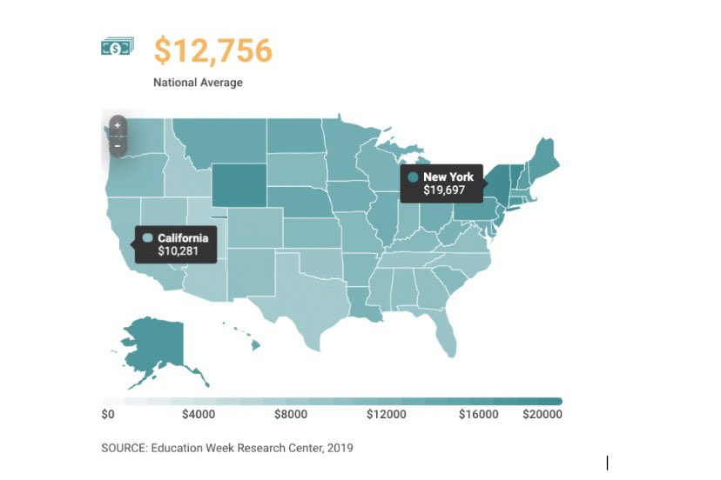
Notes:
On a per-pupil basis, California spends almost 20% less than the national spending average, & top-spending states like New York spend almost DOUBLE per-pupil! Our students & staff deserve more!

Slide 37
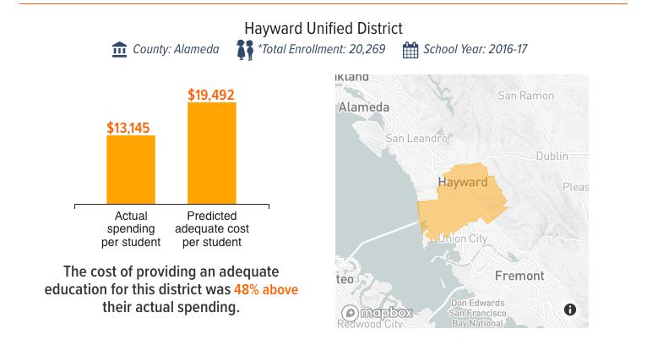
California school districts have less money to spend than they need
Source: EdSource/American Institutes for Research

Slide 38
How can parents get involved in the LCAP?
¿Cómo pueden involucrarse los padres/madres en el LCAP?
Copyright 2019, Public Advocates Inc. All Rights Reserved. Contact cgerges@publicadvocates.org for permission prior to use.

Slide 39
Engagement Involucración
In the LCAP, districts MUST show how they engaged stakeholders (students, families, community, staff).
En el LCAP, los distritos DEBEN DE demostrar cómo involucrar a las personas interesadas (estudiantes, familias, la comunidad, personal escolar).
Parents/Caregivers - Parent Advisory Committee, District English Learner Advisory Committee
Padres/Cuidadores - Comité Asesor de Padres, Comité Asesor del Distrito para Aprendices de inglés
Districts must do the following:
Los distritos deben de hacer lo siguiente:
Students - formal process to involve students throughout the development of the LCAP
Estudiantes - Proceso formal para involucrar a estudiantes durante el desarrollo del LCAP
2 public meetings about the LCAP and budget
2 juntas públicas acerca del LCAP y presupuesto
Copyright 2020, Public Advocates Inc. All Rights Reserved. Contact ajongco@publicadvocates.org for permission prior to use.

Slide 40
What is the Parent Advisory Committee?
¿Qué es el Comité Asesor de Padres?
Membership: Must include parents of students
eligible for free or reduced-price meals,
foster youth, or ELs. Other parents,
community members, and school staff may
also participate.
Duties: Advise the district in the
development of its LCAP and comment on
the plan.
Membresía: Debe incluir padres de estudiantes de bajos ingresos, jóvenes de crianza, o ELs. Otros padres, miembros de la comunidad, y personal de la escuela pueden participar.
Obligaciones: Aconsejar el distrito sobre el desarrollo del LCAP y dar comentario al plan.
Copyright 2020, Public Advocates Inc. All Rights Reserved. Contact ajongco@publicadvocates.org for permission prior to use.

Slide 41
What is the District English Learner Advisory Committee?
¿Qué es el Comité del Distrito para Aprendices de Inglés?
Districts with 15% or more ELs and 50 or more total ELs must have a DELAC.
Membership: Parents of ELs not
employed by the district must constitute
a majority (51% or more).
Duties: Advise the district on programs &
services for ELs, including LCAP
implementation.
Distritos con 15% o más de ELs o 50 o
más ELs deben tener un DELAC.
Membresía: Padres de ELs que no son personal del distrito deben constituir la mayoría (51% o más).
Obligaciones: Aconsejar el distrito sobre programas y servicios para ELs, incluyendo el LCAP.
Copyright 2020, Public Advocates Inc. All Rights Reserved. Contact ajongco@publicadvocates.org for permission prior to use.

Slide 42
What did we Learn Today?
¿Qué Aprendimos Hoy?
Bajo de la fórmula de financiamiento de control local:
Tiene el derecho de participar en las decisiones del Distrito a través de las comités del distrito
Estudiantes de alta necesidad traen fondos adicionales para su distrito que deben ser utilizados para mejorar servicios para ellos/as
El LCAP es una herramientas para qué distritos mejoren y logren cumplir con las necesidades estudiantiles
Under the Local Control Funding Formula:
You have the right to participate in decision making through district committees
High-need students bring additional money to their districts that must be used to improve services for them
The LCAP is a tool for districts to get better at meeting student needs
Copyright 2020, Public Advocates Inc. All Rights Reserved. Contact ajongco@publicadvocates.org for permission prior to use.

Slide 43
Próximos Pasos
Next Steps
Join the Parent Student Advisory Committee, District English Learner Advisory Committee or your School Site Council.
Engage in the development of your district’s LCAP!
DO NOW: Find out when the next district meetings are
Oakland - Feb 19 LCAP
Hágase parte de un Comité Asesor de Estudiantes y Padres o Comité Asesor del Distrito para Aprendices de inglés
¡Involúcrese el próximo año en su distrito en el desarrollo del LCAP!
Consulte con la página de web de su distrito para encontrar las fechas de elecciones
Para Oakand es 19 de Feb
Copyright 2020, Public Advocates Inc. All Rights Reserved. Contact ajongco@publicadvocates.org for permission prior to use.

Slide 44
www.publicadvocates.org/WeMakeLCFFWork
Copyright 2019, Public Advocates Inc. All Rights Reserved. Contact cgerges@publicadvocates.org for permission prior to use.

Slide 45
Questions?
¿Preguntas?
Sasha Shane
(510) 878 - 8990
sasha@bayareaplan.org
Angelica Jongco
(415) 625 - 8457
ajongco@publicadvocates.org
Copyright 2020, Public Advocates Inc. All Rights Reserved. Contact ajongco@publicadvocates.org for permission prior to use.

Slide 46
Comparta con el grupo en una palabra cómo se siente
Share with the group how you are feeling in one word
Copyright 2020, Public Advocates Inc. All Rights Reserved. Contact ajongco@publicadvocates.org for permission prior to use.

