Slide 1
Your Voice, Needs, and School Dollars
Dec. 12, 2019
Cindy Gerges, Public Advocates
Copyright 2019, Public Advocates Inc. All Rights Reserved. Contact cgerges@publicadvocates.org for permission prior to use.

Slide 2
Welcome
REFLECTION:
Think about a party or event that you had to plan.
What steps did you take to plan it?
What was most important to you? How did you decide?
How did it go?
Copyright 2019, Public Advocates Inc. All Rights Reserved. Contact cgerges@publicadvocates.org for permission prior to use.

Slide 3
Agenda:
4:00pm-4:20pm (20min) - Welcome
4:20pm-5:05pm (45min) - The Local Control Funding Formula and the Dashboard
5:05pm-5:15pm (10min) - BREAK
5:15pm-5:35pm (20min) - The Local Control Accountability Plan
5:35pm-5:45pm (10min) - Activity
5:45pm-6:00pm (15min) - Closing
Copyright 2019, Public Advocates Inc. All Rights Reserved. Contact cgerges@publicadvocates.org for permission prior to use.

Slide 4
Purpose: Build knowledge and comfort of students to get involved in district decision-making.
Learning Goals:
Goal 1: Understand the Local Control Funding Formula (LCFF)
Goal 2: Become familiar with the cycle of the school district’s Local Control Accountability Plan (LCAP)
Goal 3: Use data to identify student needs
Goal 4: Share various opportunities that students have to impact the LCAP to meet their needs
Copyright 2019, Public Advocates Inc. All Rights Reserved. Contact cgerges@publicadvocates.org for permission prior to use.

Slide 5
Who are high-need students?
Copyright 2019, Public Advocates Inc. All Rights Reserved. Contact cgerges@publicadvocates.org for permission prior to use.

Slide 6
High-Need Students
English Learners
Low-income Students
Foster Youth
Copyright 2019, Public Advocates Inc. All Rights Reserved. Contact cgerges@publicadvocates.org for permission prior to use.

Slide 7
WHAT’S NEW?
Multiple Measures
Fair Funding
Engagement
2
3
1
School funding is now based on who NEEDS IT MOST!
District must work with the community to decide how to spend its money!
Multiple measures of school success, including: engagement and school climate.
Copyright 2019, Public Advocates Inc. All Rights Reserved. Contact cgerges@publicadvocates.org for permission prior to use.

Slide 8
LCFF: NEW FUNDING SYSTEM
LCAP: NEW DISTRICT
PLANNING PROCESS
DASHBOARD: NEW
ACCOUNTABILITY SYSTEM
Copyright 2019, Public Advocates Inc. All Rights Reserved. Contact cgerges@publicadvocates.org for permission prior to use.

Slide 9
Highest Performance
CALIFORNIA SCHOOL DASHBOARD (“DASHBOARD”):
www.caschooldashboard.org
Blue
Green
Yellow
Orange
Lowest Performance
Red
Copyright 2019, Public Advocates Inc. All Rights Reserved. Contact cgerges@publicadvocates.org for permission prior to use.

Slide 10
WCCUSD Data
71% are High-Need students
32% are English Learners
Approximately 113 students are Foster Youth
Copyright 2019, Public Advocates Inc. All Rights Reserved. Contact cgerges@publicadvocates.org for permission prior to use.

Slide 11
The Formula
Concentration
Supplemental
Base
(2018-19)
Almost
$10,000 per
student
$$$
$$$
Copyright 2019, Public Advocates Inc. All Rights Reserved. Contact cgerges@publicadvocates.org for permission prior to use.

Slide 12
Time to Practice!
Copyright 2019, Public Advocates Inc. All Rights Reserved. Contact cgerges@publicadvocates.org for permission prior to use.

Slide 13
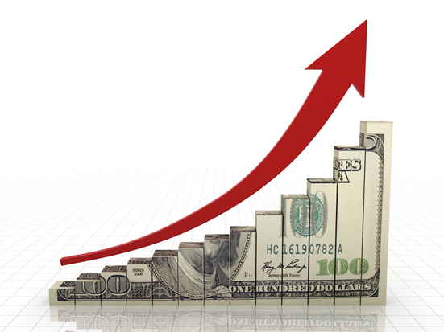
Supplemental and Concentration Funds (S&C) should be used to INCREASE or IMPROVE services for high-need students, as compared to all students.
Concentration
Supplemental
Base
(2018-19)
Almost $10,000/ student
estudiante
Copyright 2019, Public Advocates Inc. All Rights Reserved. Contact cgerges@publicadvocates.org for permission prior to use.

Slide 14
LET’S PRACTICE!
Does this service increase or improve the education of high-need students?
Yes
a) After school tutors for English Learners?
b) Superintendent's salary?
No
Maybe
c) Teacher Professional Development?
Copyright 2019, Public Advocates Inc. All Rights Reserved. Contact cgerges@publicadvocates.org for permission prior to use.

Slide 15
How much money does WCCUSD
have to spend in its budget?
Copyright 2019, Public Advocates Inc. All Rights Reserved. Contact cgerges@publicadvocates.org for permission prior to use.

Slide 16
$360,790,052
Copyright 2019, Public Advocates Inc. All Rights Reserved. Contact cgerges@publicadvocates.org for permission prior to use.

Slide 17
What is the Local Control and Accountability Plan (LCAP)?
Copyright 2019, Public Advocates Inc. All Rights Reserved. Contact cgerges@publicadvocates.org for permission prior to use.

Slide 18
The LCAP
District’s plan for addressing student needs.
Called Local Control and Accountability Plan (LCAP for short).
Must reflect a number of priorities, including 1) parent and student engagement and 2) school climate.
Copyright 2019, Public Advocates Inc. All Rights Reserved. Contact cgerges@publicadvocates.org for permission prior to use.

Slide 19
Phase 1: Planning
Make revisions and refine the plan using the information gathered in the Third Phase
Determine needs, define goals, actions, services, and metrics
Phase 4:
Modify
LCAP Process
Phase 2: Do
Analyze, review, and share data. Ask: What is working and what is not working?
Gather information and data. How do we know that we are being effective?
Phase 3: Reflect
Copyright 2019, Public Advocates Inc. All Rights Reserved. Contact cgerges@publicadvocates.org for permission prior to use.

Slide 20
How can students get involved in the district and school plan?
Copyright 2019, Public Advocates Inc. All Rights Reserved. Contact cgerges@publicadvocates.org for permission prior to use.

Slide 21
What is the District Local Control Accountability Plan Parent Student Committee (DLCAPS)?
Membership: Must include parents of students
eligible for free or reduced-price meals,
foster youth, or ELs. Other parents,
community members, and school staff may
also participate.
Duties: Advise the district in the
development of its LCAP and comment on
the plan.
Copyright 2019, Public Advocates Inc. All Rights Reserved. Contact cgerges@publicadvocates.org for permission prior to use.

Slide 22
Engagement
In the LCAP, districts MUST show how they engaged stakeholders (students, families, community, staff).
Parents/Caregivers - Parent Student Advisory Committee (DLCAPS), District English Learner Advisory Committee (MDAC)
Students - formal process to involve students throughout the development of the LCAP
2 public meetings about the LCAP and budget
Districts must do the following:
Copyright 2019, Public Advocates Inc. All Rights Reserved. Contact cgerges@publicadvocates.org for permission prior to use.

Slide 23
What is the School Site Council?
A group consisting of:
Parents/guardians/community members (and students for high schools);
Principals;
Teachers; and
Other school staff
working together to decide how the school spends federal and state funds to best serve students.
Every year, the School Site Council (SSC) develops, annually reviews, and updates the School Plan for Student Achievement (SPSA).
Copyright 2019, Public Advocates Inc. All Rights Reserved. Contact cgerges@publicadvocates.org for permission prior to use.

Slide 24
Secondary School SSC Composition
6
School Staff
6
Community Members & Students
1 Principal
1 Other Staff
3 Students
4 Teachers
3 Parents or Community Members
Copyright 2019, Public Advocates Inc. All Rights Reserved. Contact cgerges@publicadvocates.org for permission prior to use.

Slide 25
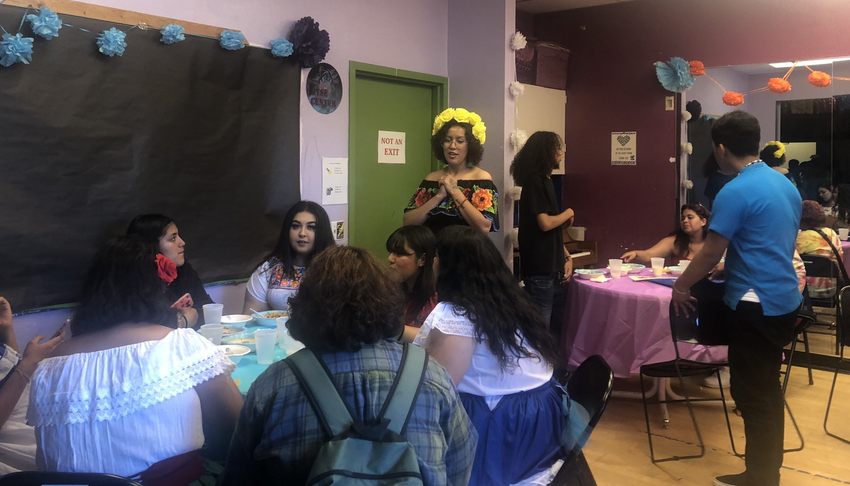
It’s your responsibility to ensure that the $$$
Makes a Difference!
Copyright 2019, Public Advocates Inc. All Rights Reserved. Contact cgerges@publicadvocates.org for permission prior to use.

Slide 26
What did we Learn Today?
Under the Local Control Funding Formula:
You have the right to participate in decision making through district and school committees
High-need students bring additional money to their districts that must be used to improve services for them
The LCAP is a tool for districts to get better at meeting student needs
Copyright 2019, Public Advocates Inc. All Rights Reserved. Contact cgerges@publicadvocates.org for permission prior to use.

Slide 27
Next Steps
Join the District Local Control & Accountability Plan Committee (DLCAPS) or your School Site Council (SSC).
Engage in the budget cut process & development of your district’s LCAP or SPSA next year.
Support Schools and Communities First!
Copyright 2019, Public Advocates Inc. All Rights Reserved. Contact cgerges@publicadvocates.org for permission prior to use.

Slide 28
Share with the group how you are feeling in one word
Copyright 2019, Public Advocates Inc. All Rights Reserved. Contact cgerges@publicadvocates.org for permission prior to use.

Slide 29
Questions?
Cindy Gerges
cgerges@publicadvocates.org
@CindyGerges
Copyright 2019, Public Advocates Inc. All Rights Reserved. Contact cgerges@publicadvocates.org for permission prior to use.

